Slide 1







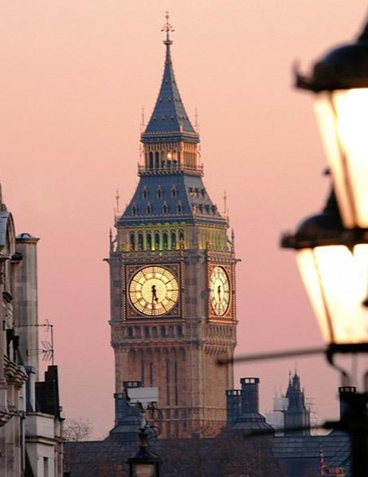


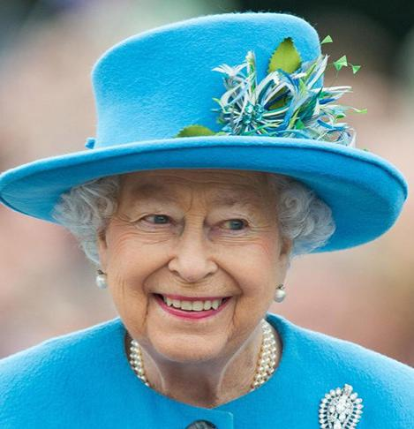
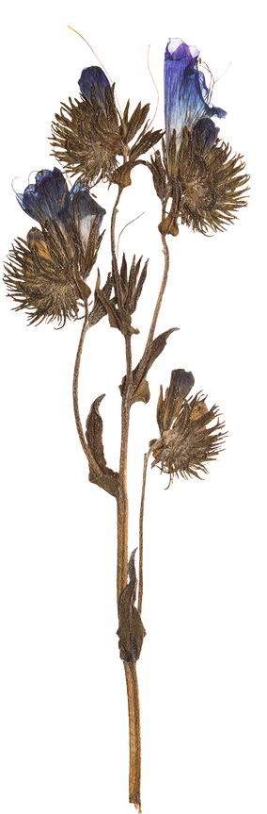





Great
Britain

Slide 2

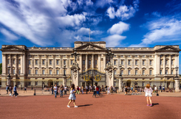


Buckingham Palace
  Buckingham Palace is the official residence of Queen Elizabeth. It is located near Green Park. When the Queen is in the residence, the Royal Standard flies over Buckingham Palace.
  There are 775 rooms where members of the Royal family and their servants live. There are also rooms for guests. There are offices, on-site post and even swimming pool in the palace.
  Throughout the year right in front of Buckingham Palace the ceremony of the Changing of the Guard takes place, attracting a lot of tourists.

Slide 3
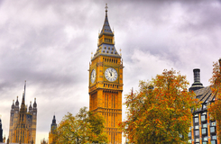
Big Ben
Big Ben is the name of the Great bell of the clock at the Palace of Westminster. Nowadays this name mostly refers to the clock and the clock tower.
In 2012 the tower was renamed to celebrate the Diamond Jubilee of the Queen and is now officially known as the Elizabeth Tower.
The height of the tower is 96,3 metres. Big Ben is one of the most prominent symbols of the United Kingdom.

Slide 4
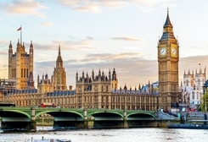
Westminsterl
Westminster is a historical area of central London with several famous landmarks.
Westminster Abbey, a Gothic church, is located there. The church is a traditional place of coronation and burial site for all British kings and queens.
Not far from the church there is the Palace of Westminster which is the meeting place of the House of Commons and the House of Lords.

Slide 5
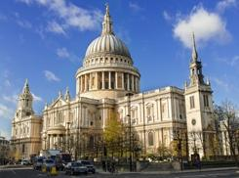
St. Paul’s Cathedral
St. Paul’s Cathedral is located at the highest point of the City of London, Ludgate Hill. The Cathedral was seriously damaged during the Great Fire of London. It was redesigned by Christopher Wren, a famous architect.
There are three Galleries and 17 bells in the Cathedral. The largest bell is called Great Paul. The funerals of a lot of notable figures have occured at the cathedral.

Slide 6
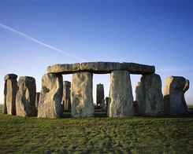
Stonehenge
Stonehenge is a well-known prehistoric monument which is located in Wiltshire, England. Huge standing stones which are 4,1 metres long and 2,1 metres wide make a ring.
The real purpose of this structure is still a subject of much controversy. It is believed that Stonehenge served as an ancient astronomical observatory.
Stonehenge is added to the list of UNESCO World Heritage Sites.

Slide 7
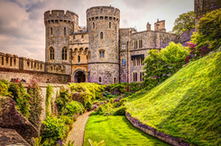
Windsor Castle
Windsor Castle is a residence of the British monarchy. Windsor Castle is the largest residential castle in the world. A lot of official visits take place here. It is also open for tourists.
Windsor Castle is located on a hill and is surrounded with lush greenery.
The castle has been reconstructed a number of times but the location of its main buildings remains unchanged.

Slide 8
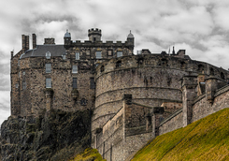
Edinburgh Castle
Edinburgh Castle is an ancient fortress which is located right in the centre of Edinburgh.
Edinburgh Castle is located on the Castle Rock, at the top of the Royal Mile.
The castle has a very good strategic position and can only be easily approached from one side. Nowadays, Edinburgh Castle is one of Scotland’s most popular tourist attractions.

Slide 9
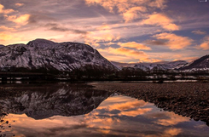
Ben Nevis
Ben Nevis is a mountain in the Scottish Highlands. It is the highest mountain in the British Isles. Its height is 1,344 metres.
Ben Nevis is a very popular tourist destination. The mountain is also of great interest to experienced climbers.
The summit of the mountain is a big plateau with an observatory, shelter and war memorial.

Slide 10




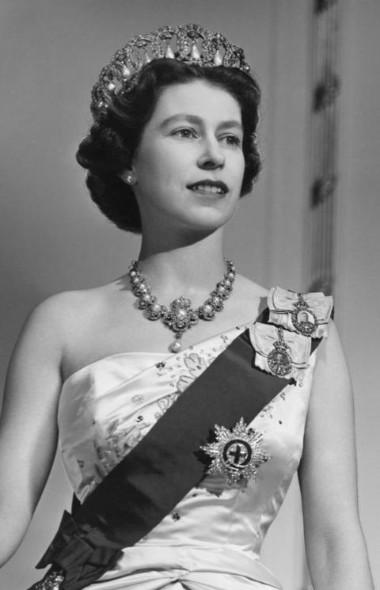

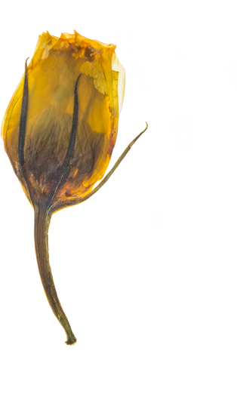
Thank you for the attention
hope you enjoyed it, I think the queen will appreciate it

